Slide 1
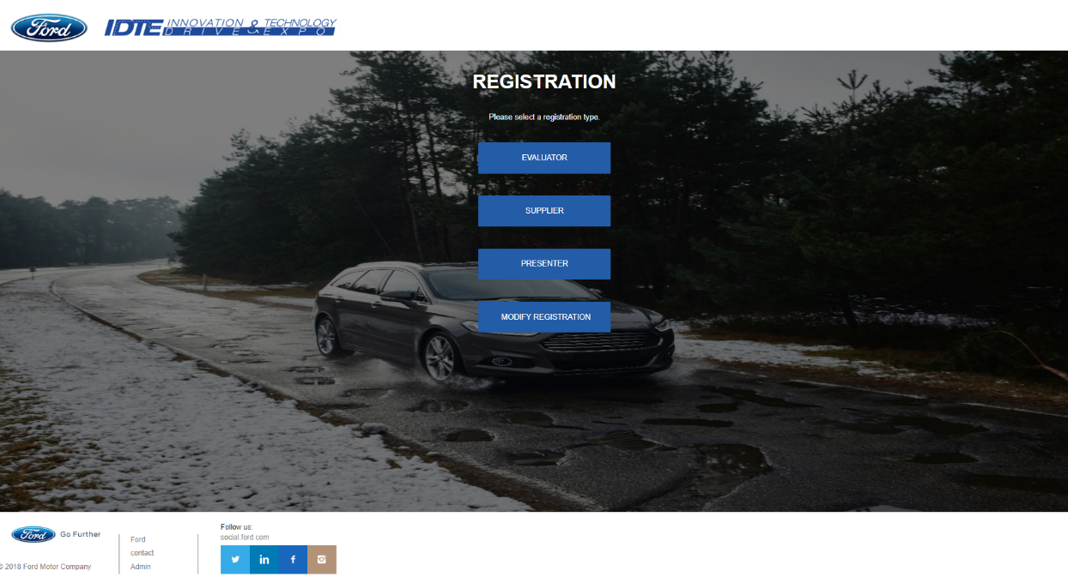
IDTE – Innovation Drive and Technology Expo is a five-day yearly in-house event showcasing advanced and research technologies to senior management. This event helps Ford Motor Company in pursuing the highly ranked technologies for production.
The registration is for 3 groups:
Evaluators: Ford upper management evaluating shown technologies
Presenters: Ford employees presenting the technologies to the evaluators
Suppliers: Outside companies/universities working with Ford teams on advanced and research projects

Slide 2
The following is an example of information to be entered for registration. The site is not complete yet.

Slide 3
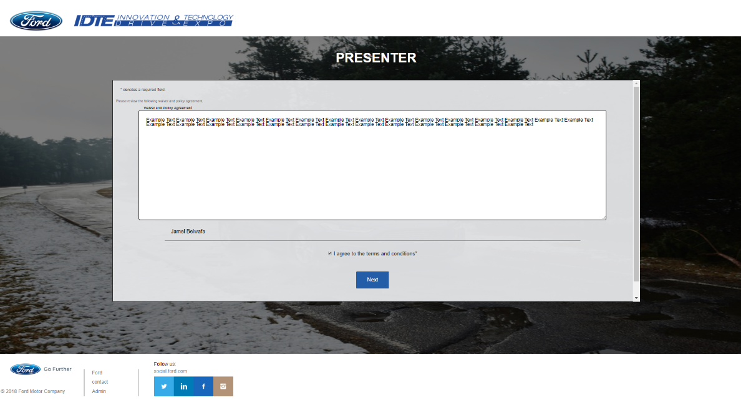

Slide 4
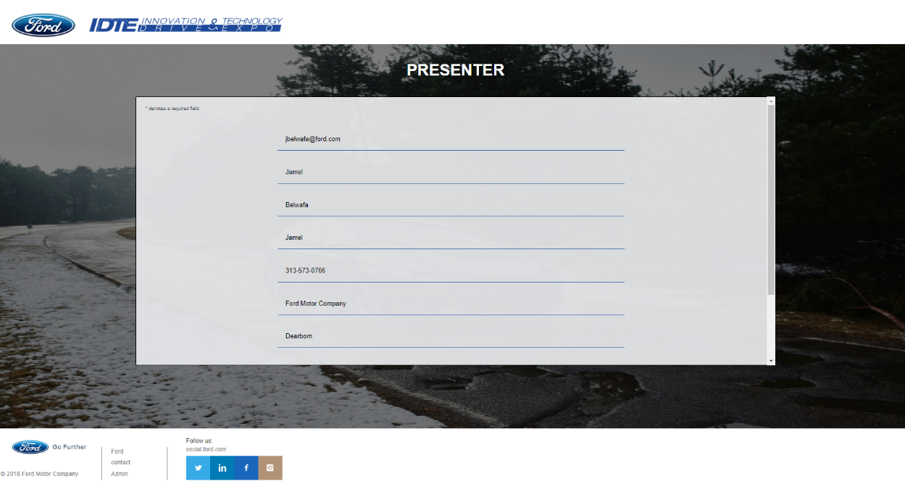

Slide 5
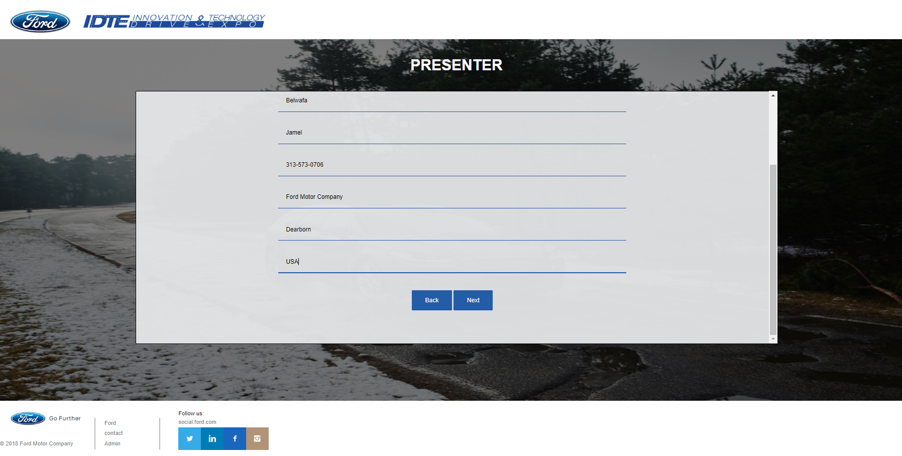

Slide 6
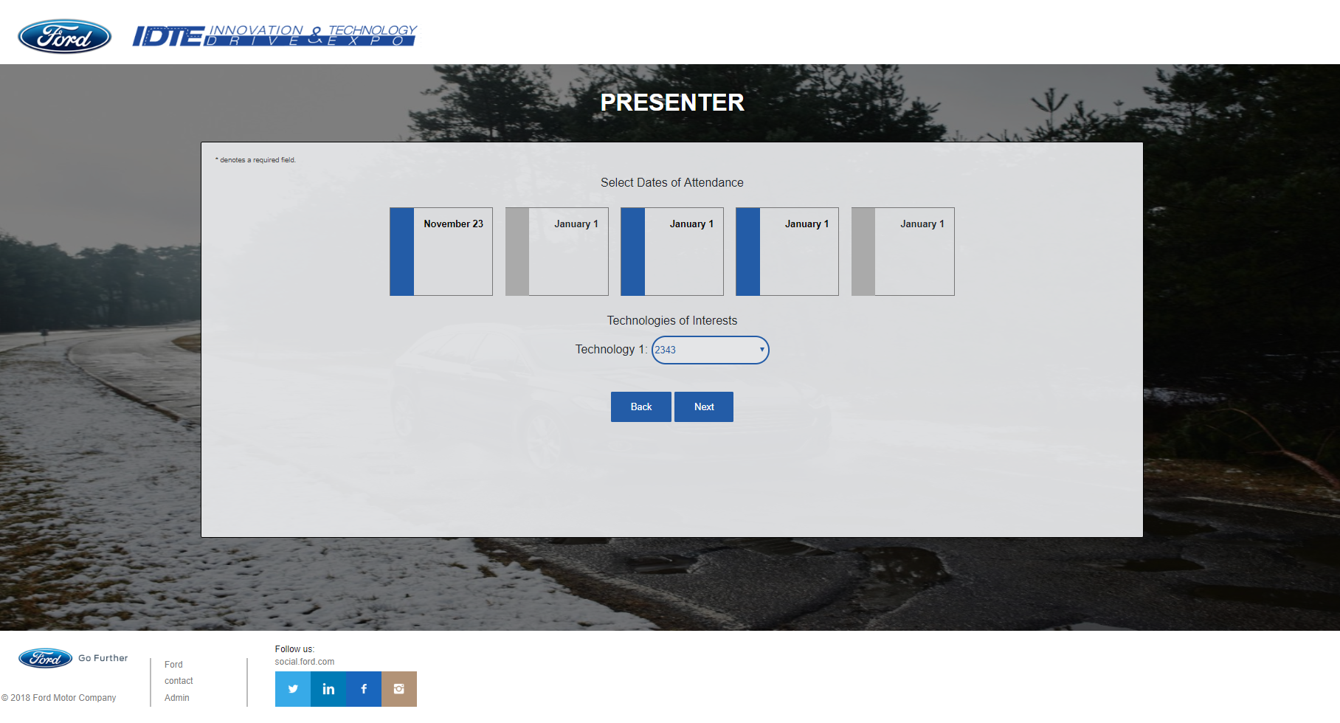

Slide 7
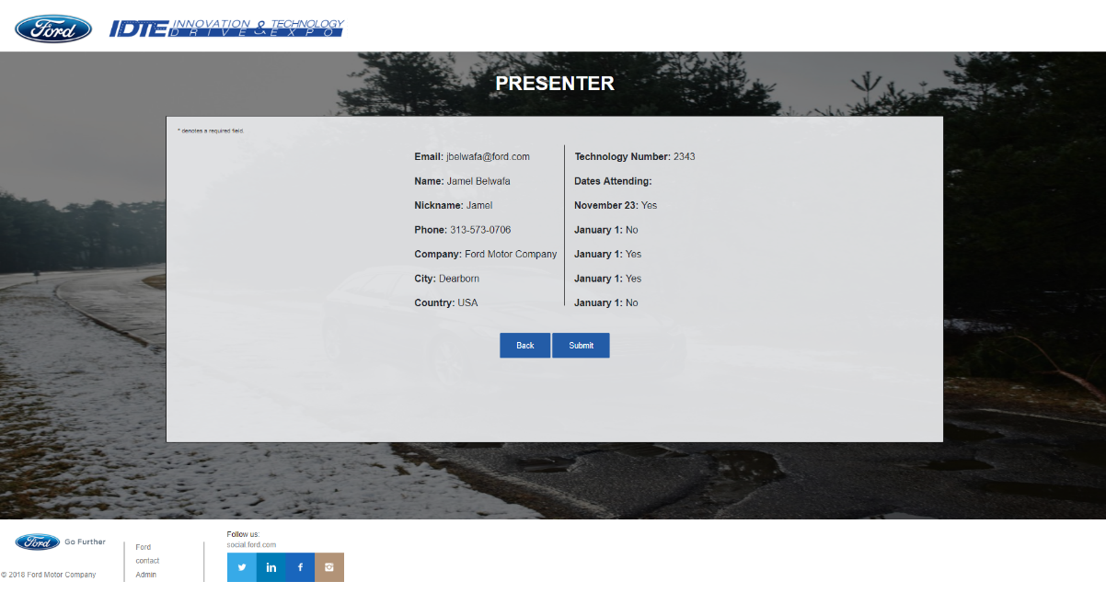
ENTRY CONFIRMATION BEFORE SUBMISSION

Slide 8
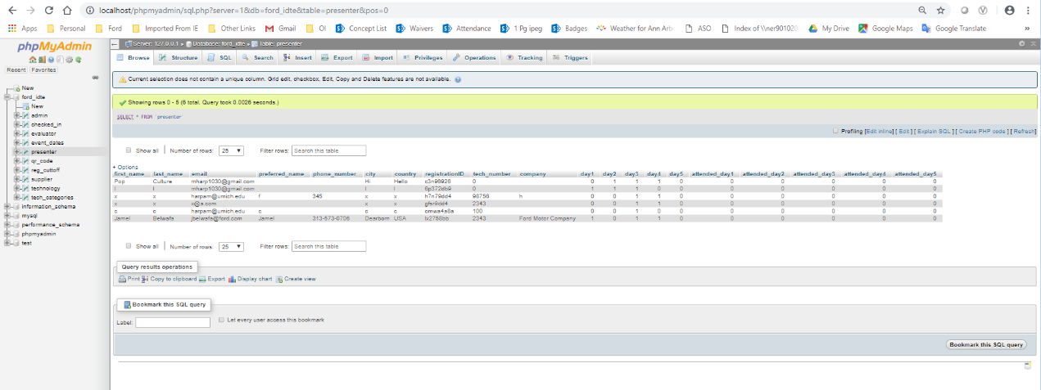
Example of how the database will look like.

